Slide 1
Stacks

Slide 2
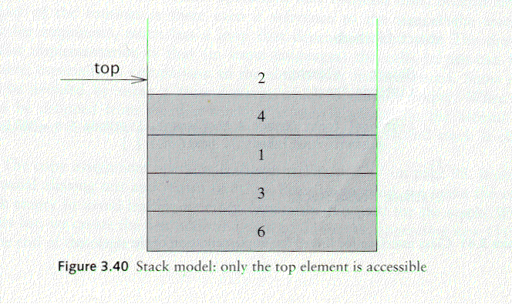
Stack Overview
Stack: A Stack is a list of elements in which an element may be inserted or deleted only at one end called the top of the stack Lists( LIFO (Last In, First Out) )
Basic operations of stack
“Push” is the term used to insert an element into a stack.
“Pop” is the term used to delete an element from stack. etc.
empty stack
push an element
push another
pop
top
B
top
top
top
A
A
A

Slide 3
Implementations of stacks
Any list implementation could be used to implement a stack
Arrays (static: the size of stack is given initially)
Linked lists (dynamic: never become full)
Array Representation:
1 | 2 | 3 | 4 | 5 | 6 | 7 | 8
XXX | YYY | ZZZ | AAA | BBB
TOP
MAXSTK

Slide 4
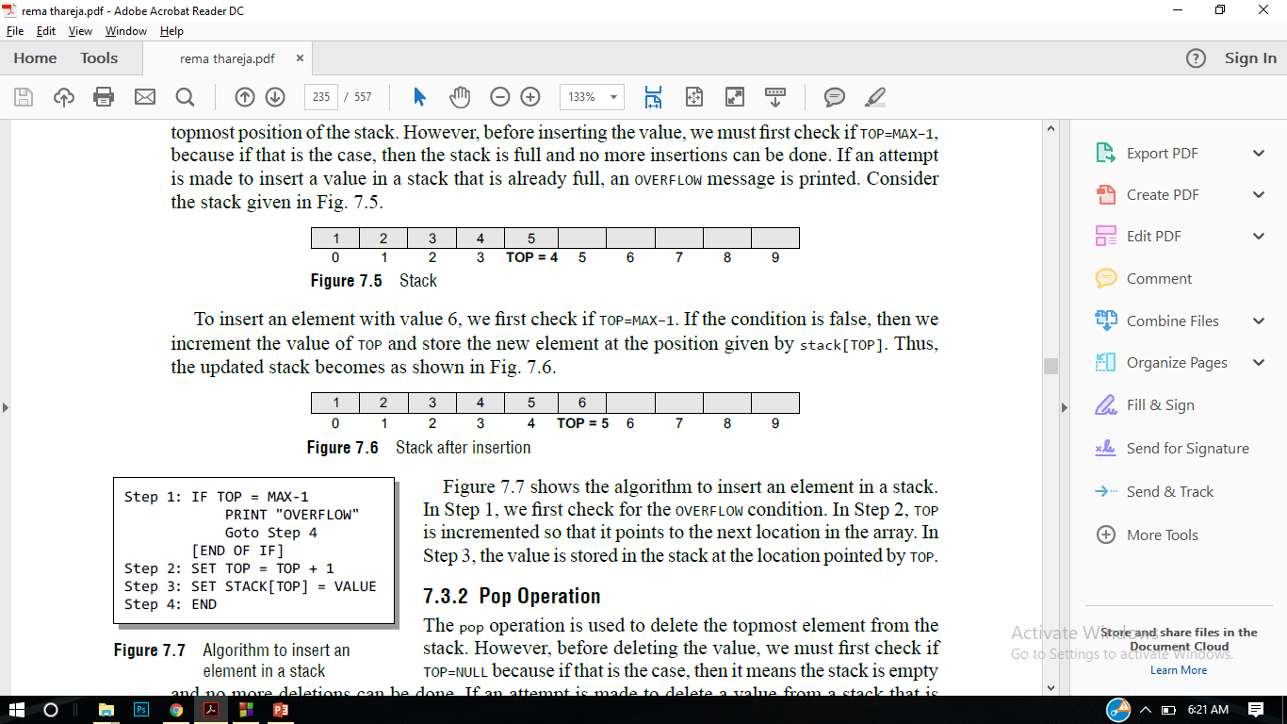

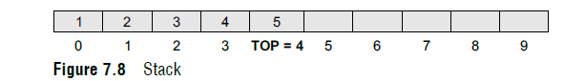

Array Implementation

Slide 5
Stack implementation with arrays #include <iostream> #include <stdlib.h> #define MAX 3 // Altering this value changes size of stack created int st[MAX], top=-1; void push(int st[], int val); int pop(int st[]); int peek(int st[]); void display(int st[]); int main() { int val, option; do { cout<<"\n *****MAIN MENU*****"; cout<<"\n 1. PUSH"; cout<<"\n 2. POP"; cout<<"\n 3. PEEK"; cout<<"\n 4. DISPLAY"; cout<<"\n 5. EXIT"; cout<<"\n Enter your option: "; cin>>option; | switch(option) { case 1: cout<<"\n Enter the number to be pushed on stack: "); cin>>val); push(st, val); break; case 2: val = pop(st); if(val != -1) cout<<"\n The value deleted from stack is: ", val); break; case 3: val = peek(st); if(val != -1) cout<<"\n The value stored at top of stack is: ", val); break; case 4: display(st); break; } }while(option != 5); return 0; }

Slide 6
void push(int st[], int val) { if(top == MAX-1) { cout<<"\n STACK OVERFLOW"; } else { top++; st[top] = val; } } int pop(int st[]) { int val; if(top == -1) { cout<<"\n STACK UNDERFLOW"; return -1; } else { val = st[top]; top--; return val;} } | void display(int st[]) { int i; if(top == -1) cout<<"\n STACK IS EMPTY"; else { for(i=top;i>=0;i--) cout<<"\n ",st[i]; cout<<"\n"; // Added for formatting purposes } } int peek(int st[]) { if(top == -1) { cout<<"\n STACK IS EMPTY"; return -1; } else return (st[top]); }

Slide 7
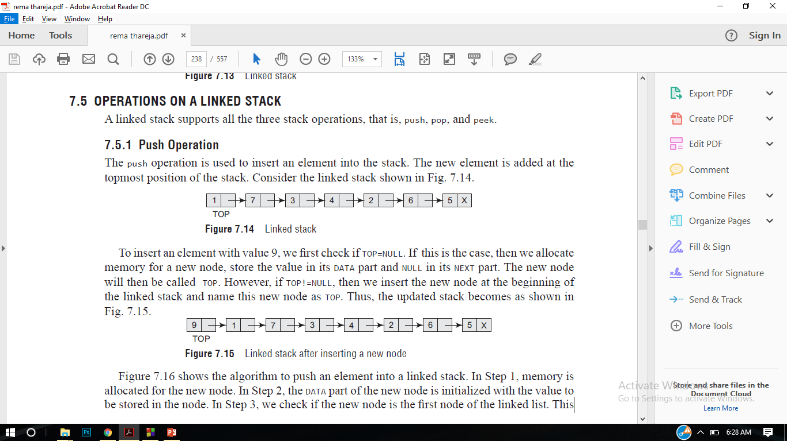
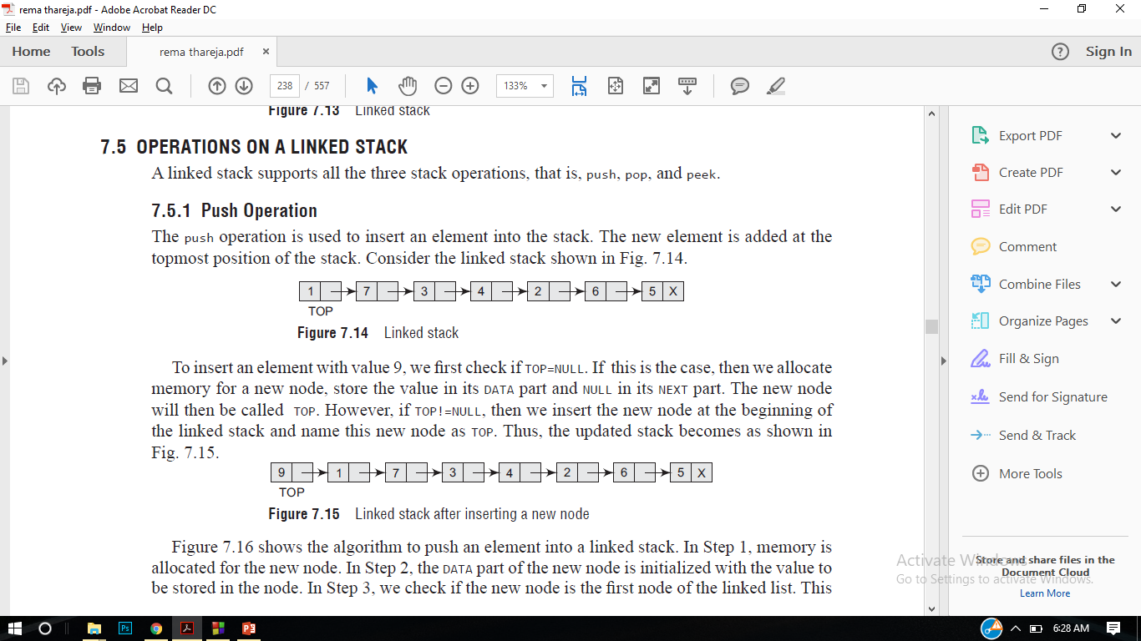
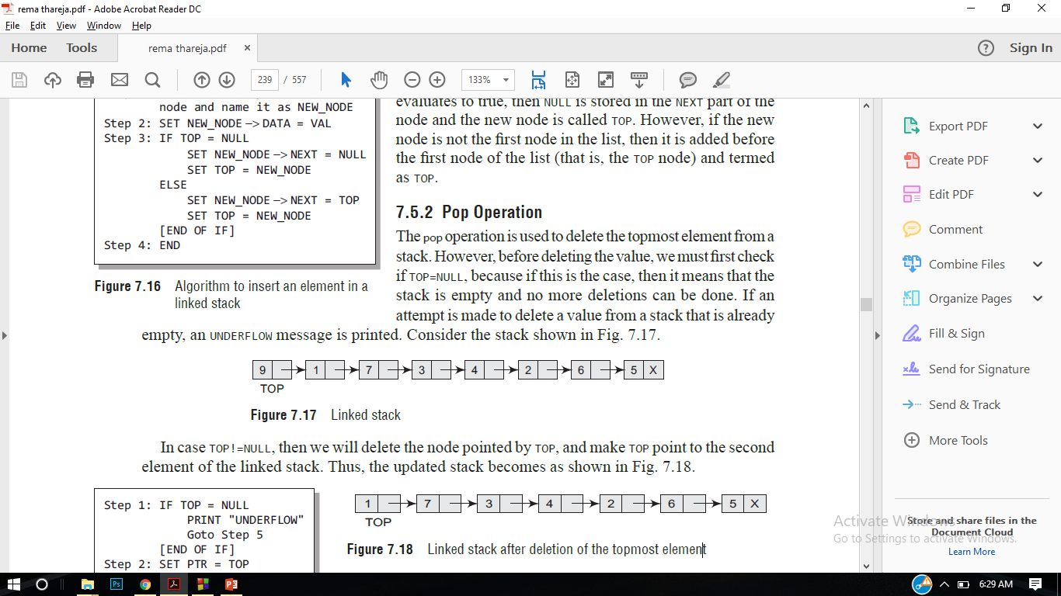
LinkedList Implementation of Stack

Slide 8
Stack implementation using LinkedList #include <iostream> #include<stdlib.h> using namespace std; struct stack{ int data; struct stack *next; }; struct stack *top =NULL; struct stack *push(struct stack *top, int value) { struct stack *temp; temp = new stack(); temp->data =value; if(top == NULL) { top = temp; top->next = NULL; } else{ temp->next = top; top=temp; } | return top; } struct stack *pop(struct stack *top) { struct stack *temp; temp = top; if(top == NULL) { cout<<"Empty stack"; } else{ top=top->next; cout<<"The value being deleted:::"<<temp->data; free(temp); } return top; } int peek(struct stack *top) { return top->data; } struct stack *display(struct stack *top) { struct stack *ptr = top; if(top==NULL)

Slide 9
{ cout<<"stack is empty"; } else { while(ptr!=NULL) { cout<<ptr->data<<endl; ptr=ptr->next; } } return top; } int main() { int choice,value; cout<<"Enter choice"; cin>>choice; while(1) { switch(choice) { case 1: cout<<"Enter the value"; | cin>>value; top = push(top,value); break; case 2: top=pop(top); break; case 3: top=display(top); break; case 4: int value1 = peek(top); cout<<value1<<endl; break; // default: // cout<<"Invalid Input"; } cout<<"Enter choice"; cin>>choice; } return 0; }

Slide 10
Application of Stacks:
Evaluating postfix expressions
Converting Infix to postfix expression
Tower of Hanoi problem
Factorial of a number
Fibonacci series

Slide 11
Arithmetic Expression: Polish Notation
Polish Notation:
Infix, postfix, and prefix notations are three different but equivalent notations of writing algebraic expressions.
Infix notation :the operator is placed in between the operands. For example, A+B; here, plus operator is placed between the two operands A and B.
Postfix notation : better known as Reverse Polish Notation or RPN. the operator is placed after the operands. For example, if an expression is written as A+B in infix notation, the same expression can be written as AB+ in postfix notation. The order of evaluation of a postfix expression is always from left to right. Even brackets cannot alter the order of evaluation.
Prefix notation : In a prefix notation, the operator is placed before the operands. For example, if A+B is an expression in infix notation, then the corresponding expression in prefix notation is given by +AB.

Slide 12
Evaluation of postfix expression:-
This algorithm finds the value of arithmetic expression P written in postfix expression
Add a right parenthesis “) ” at the end of P.
Scan P from left to right and repeat steps 3 and 4 for each element of P until “)”
is encountered.
3. If any operand is encountered, put it on stack.
4. If any operator © is encountered, then
(a) Remove the top two elements from the stack, where A is the top
element and B is the next to top element
(b) Evaluate B © A
(c) Place the result of (b) back on the stack.
[END IF]
[END WHILE]
5. Set VALUE equal to the top element of stack.
6. Exit

Slide 13
EXAMPLE=
Q: 5*(6+2)-12/4
Postfix :5 6 2 + * 12 4 / -
Symbol Scanned | STACK
5 | 5
6 | 5,6
2 | 5,6,2
+ | 5,8
* | 40
12 | 40,12
4 | 40,12,4
/ | 40,3
- | 37
)

Slide 14
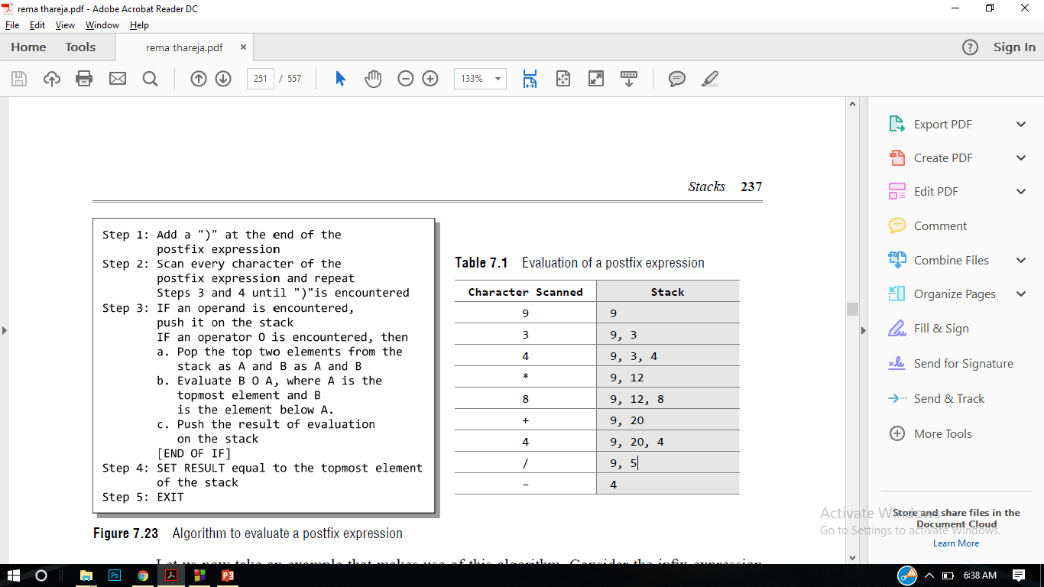
Example of Evaluation
Let us now take an example that makes use of this algorithm. Consider the infix expression given as 9 – ((3 * 4) + 8) / 4. Evaluate the expression into postfix.

Slide 15
Conversion of infix to postfix expression:-
This algo finds the value of arithmetic expression P written in postfix expression
Push “(“onto Stack, and add “)” to the end of X.
Scan X from left to right and repeat Step 3 to 6 for each element of X until the Stack is empty.
If an operand is encountered, add it to Y.
If a left parenthesis is encountered, push it onto Stack.
If an operator is encountered ,then:
Repeatedly pop from Stack and add to Y each operator (on the top of Stack) which has the same precedence as or higher precedence than operator.
Add operator to Stack. [End of If]
If a right parenthesis is encountered ,then:
Repeatedly pop from Stack and add to Y each operator (on the top of Stack) until a left parenthesis is encountered.
Remove the left Parenthesis. [End of If] [End of If]
END.

Slide 16
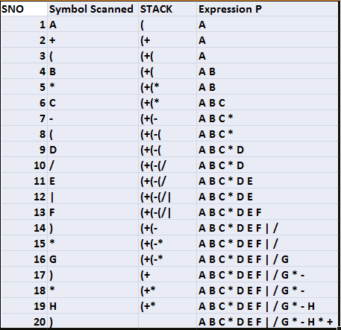
Convert A+(B*C-(D/E|F)*G)*H into Postfix using Algo

Slide 17
Example of Conversion(Practice Problem)
A+[(B+C)+(D+E)*F]/G
A+[(BC+) + (DE+) * F]/G
A+[(BC+) + (DE+F *)]/G
A+[BC+DE+F*+]/G
ABC+DE+F*+G/+

Slide 18
Practice
1.((A+B)*D) Ȋ (E-F)
2. (A-B)*(D/E)
3. (A+B Ȋ D)/(E-F)+G
4. A*(B+D)/E-F*(G+H/K)
5. (A-B)*(D/E)
6. (A+B Ȋ D)/(E-F)+G

Slide 19
Recursion:
Suppose P is a procedure containing either a call statement to itself or a call statement to a second procedure that may eventually result in a call statement back to the original procedure P then P is called a Recursive Procedure. A program will not continue to run indefinitely a recursive procedure must have the following two properties:
Base case, in which the problem is simple enough to be solved directly without making any further calls to the same function.
Recursive case, in which first the problem at hand is divided into simpler sub-parts. Second the function calls itself but with sub-parts of the problem obtained in the first step. Third, the result is obtained by combining the solutions of simpler sub-parts.
Factorial

Slide 20
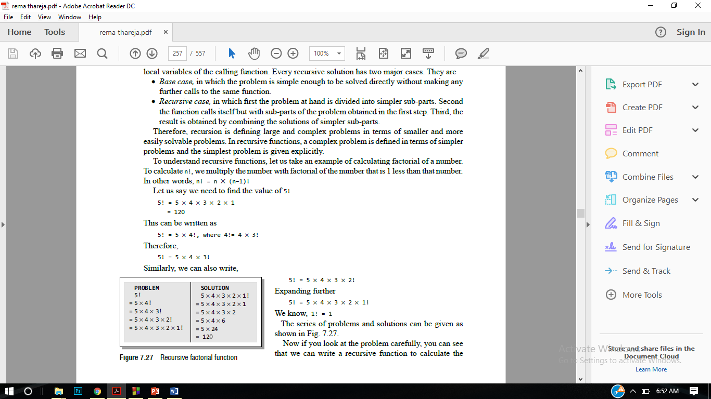
calculate n!, we multiply the number with factorial of the number that is 1 less than that number.
In other words, n! = n * (n–1)!
Let us say we need to find the value of 5!
5! = 5 * 4 * 3 * 2 * 1 = 120
This can be written as
5! = 5 * 4!, where 4!= 4 * 3!
Therefore,
5! = 5 * 4 * 3!

Slide 21
Base case is when n = 1, because if n = 1, the result will be 1 as 1! = 1.
Recursive case of the factorial function will call itself but with a smaller value of n, this case can be given as factorial(n) = n × factorial (n–1)
#include <iostream>
int Fact(int); // FUNCTION DECLARATION
int main()
{
int num, val;
cout<<"\n Enter the number: ";
cin>>num;
val = Fact(num);
cout<<"\n Factorial of “<< num << “is ” <<val;
return 0;
}
int Fact(int n)
{
if(n==1)
return 1;
else
return (n * Fact(n–1)); }

Slide 22
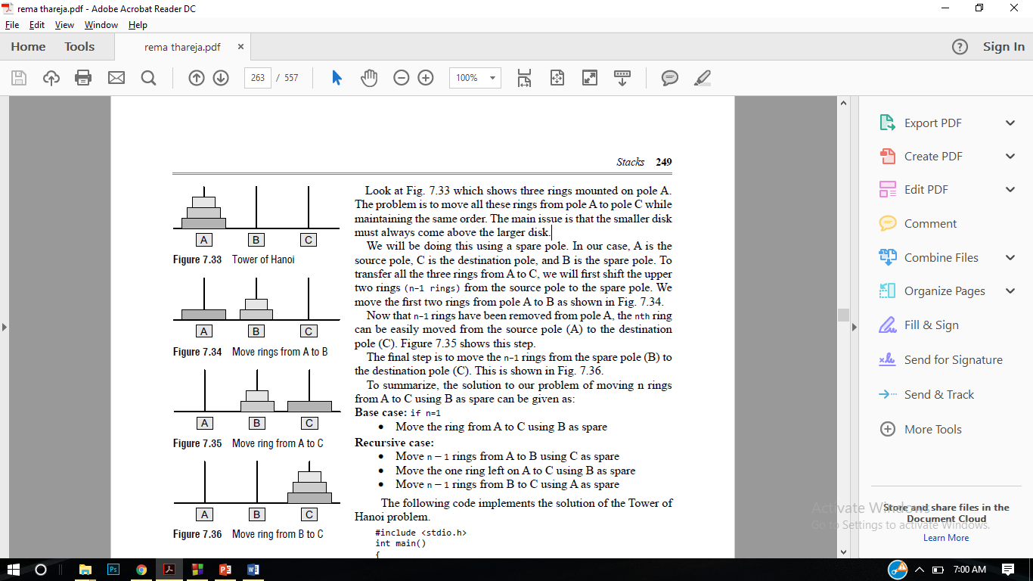
Tower of Hanoi
The tower of Hanoi is one of the main applications of recursion. It says, ‘if you can solve n–1 cases, then you can easily solve the nth case’.
The problem is to move all these rings from pole A to pole C while maintaining the same order. The main issue is that the smaller disk must always come above the larger disk.
We will be doing this using a spare pole. In our case, A is the source pole, C is the destination pole, and B is the spare pole. To transfer all the three rings from A to C
, we will first shift the upper two rings (n–1 rings) from the source pole to the spare pole.
To summarize, the solution to our problem
of moving n rings from A to C using B
as spare can be given as:
Base case: if n=1
Move the ring from A to C using B
as spare
Recursive case:
Move n – 1 rings from A to B using C as
spare
Move the one ring left on A to C using B
as spare
Move n – 1 rings from B to C using A
as spare

Slide 23
#include <iostream>
using namespace std;
void towerOfHanoi(int n, char from_rod, char to_rod, char helping_rod)
{
if (n == 1)
{
cout<<"\n Move disk 1 from rod " << from_rod<< "to rod"<< to_rod;
return;
}
towerOfHanoi(n-1, from_rod, helping_rod, to_rod);
cout<<"\n Move disk "<<n<<" from rod " << from_rod<< "to rod"<< to_rod;
towerOfHanoi(n-1, helping_rod, to_rod, from_rod);
}
int main()
{
int n = 4; // Number of disks
towerOfHanoi(n, 'A', 'C', 'B'); // A, B and C are names of rods
return 0;
}

Slide 24
Questions
Ques : Implement push and pop using arrays.
Ques : Convert the following infix expression into postfix and prefix.
A – B + C (b) A * B + C / D
(A – B ) + C * D / E – C
(A * B) + (C / D) – ( D + E)
((A – B) + D / ((E + F) * G))
( A – 2 * (B + C) / D * E) + F
14 / 7 * 3 – 4 + 9 / 2
Ques : Write a program/Algorithm to evaluate a postfix expression 10 + ((7 – 5) + 10)/2.
Ques : Explain the recursion by giving one example.
Ques : Implement push and pop using linked list.
Ques : Explain the problem of towers of Hanoi.

Slide 25
X --→ 9 – ((3 * 4) + 8) / 4
9- ( 34 * + 8) /4
9- ( 3 4 * 8 +) /4
9 – 3 4 * 8 + 4 /
9 34 * 8+4 / -)
4

Slide 26
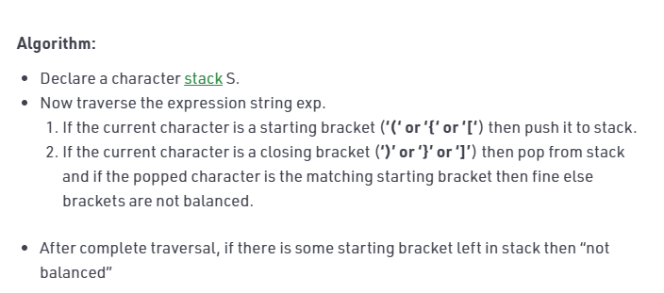
Parenthesis Checker Algorithm

Slide 27
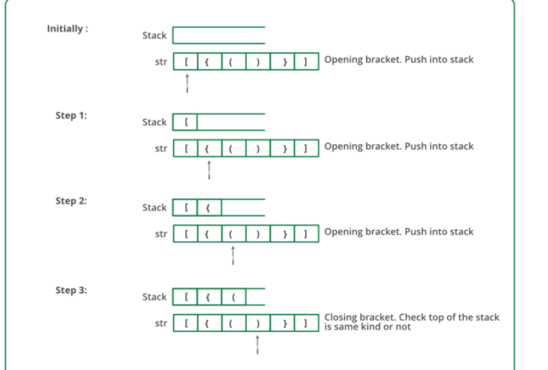

Slide 28
